Slide 1
INTELLIGENCE OF BIOLOGICAL SYSTEMS
GENE LANGUAGE ANALYTICS
DONE BY :
1.ABDUL AZHAR - CB.SC.U4AIE24301
2.DEEPAK PRABHU.R - CB.SC.U4AIE24312
3.PRANESH.M - CB.SC.U4AIE24345
4.SANDHIYA.D - CB.SC.U4AIE24353

Slide 2
INDEX
1.INTRODUCTION
2.LITERATURE REVIEW
3.PROBLEM STATEMENT
4.OBJECTIVES
5.METHODOLOGY
6.EXPECTED RESULTS
7.APPLICATIONS
8.REFERENCES

Slide 3
INTRODUCTION
Genes as the Language of Life
Genes store biological instructions that guide growth and survival.
They act as a universal code for transmitting information.
DNA/RNA as Biological Text
DNA/RNA sequences use four nucleotides (A, T/U, G, C) like alphabets.
Codons (3 bases) form “words” → proteins = “sentences” of life.
Gene Language Analytics
Treats genetic code like structured text for analysis.
Uses AI/NLP to find patterns, detect mutations, and predict functions.
Subdomain of IBS
Gene Language Analytics focuses on genetic information processing.

Slide 4
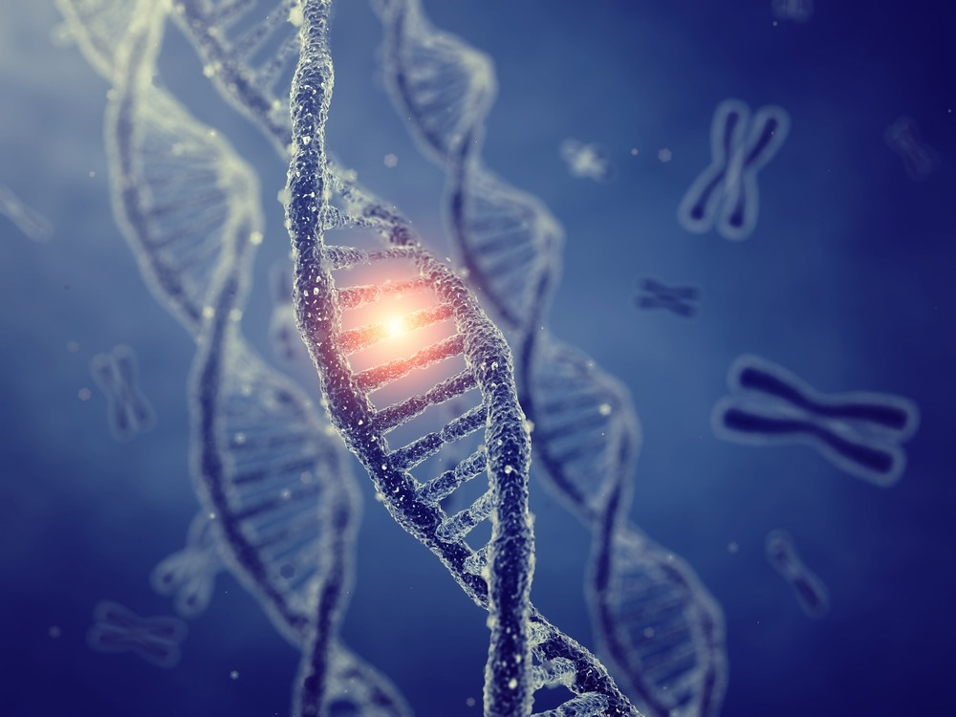
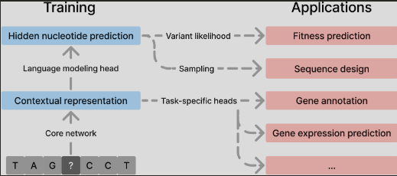

Slide 5
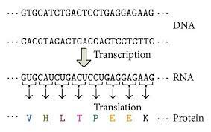
OBJECTIVES
Treat genetic code as a language of life.
Perform sequence analytics (ATGC counts, codon usage, entropy).
Identify recurring patterns/motifs.
Apply NLP-inspired models (n-grams, Markov chains).
Demonstrate simple predictive analysis.
Explore applications in biology & AI.

Slide 6
PROBLEM STATEMENT
Biological data (genomes) is massive and complex.
Traditional biology struggles to capture hidden patterns in genetic code.
Need a way to decode genetic information like a language → to detect mutations(non-trivial), understand gene function, and study evolution.
Mutations and variations in DNA can be subtle (like a single-letter typo) but lead to serious diseases (e.g., cancer, genetic disorders).
Information encoding in genes is not fully understood; we know codons → proteins, but the deeper "grammar" of how sequences regulate function is still a challenge.
Thus, there is a need to bridge biology and AI/NLP so that genetic code can be treated like a language for better understanding, prediction, and disease detection.

Slide 7
METHODOLOGY
1. Data Collection
Download DNA sequences from NCBI/GenBank.
Choose specific genes or small genome segments.
2. Preprocessing
Represent DNA as a string of nucleotides (A, T, G, C).
Segment into codons (3-base units) for analysis.
3. Sequence Analysis
Count nucleotide frequencies (A/T/G/C).
Compute codon usage bias.
Measure Shannon entropy (order vs randomness).

Slide 8
4. Pattern and Motif Detection
Identify recurring subsequences (like linguistic “grammar”).
Compare motif positions across sequences.
5. NLP-inspired Modeling
N-grams: capture local sequence dependencies.
Markov chains: model probability of next base.
Explore embeddings for codon similarity.
6. Demonstration / Validation
Run a small Python script to predict next nucleotide.
Visualize results with graphs (frequency, codon distribution).

Slide 9
EXPECTED RESULTS
Pattern Discovery → Identify recurring motifs, codon usage patterns, or sequence similarities.
Classification → Accurately classify genes/sequences based on their function or origin.
Prediction → Forecast mutations, gene expression levels, or disease associations.
Knowledge Extraction → Reveal hidden biological insights by treating DNA/RNA as a language.

Slide 10
APPLICATIONS
Medical Genomics – Detect mutations linked to genetic disorders & cancer.
Drug Discovery – Identify target genes & protein pathways.
Evolutionary Biology – Compare codon usage across species.
Synthetic Biology – Design artificial gene sequences for research.
Bioinformatics Tools – Enhance gene prediction & annotation.
AI-Biology Integration – Apply NLP/ML models to genomic data.

Slide 11
CONCLUSION
Genes behave like a biological language, with letters (ATGC), words (codons), and sentences (proteins).
Gene Language Analytics uncovers patterns, structure, and predictive power in DNA.
Acts as a subdomain of IBS, highlighting genetic information as a form of intelligence.
Bridges biology and computational intelligence, for medicine, evolution, and AI-driven discoveries.

Slide 12
REFERENCES
https://www.ncbi.nlm.nih.gov/genbank/
https://www.ensembl.org
https://www.nature.com/ng/
https://journals.plos.org/ploscompbiol/

Slide 13
THANK YOU

